Slide 1
Programs - Debugging
CS 0449
Jarrett Billingsley

Slide 2
Class announcements
don't you love the crisp cool winter air
OH WAIT
I mean it’s still nice but...

Slide 3
Writing fewer bugs in the first place

Slide 4
Removing the training wheels
as your programs get bigger…
you cannot write them all at once and then compile and test.
does it compile?
TEST WHAT YOU JUST WROTE.
"it compiles" is a very weak indication of correctness.
write a little bit of code
yes
no
think of the compiler more like a spell checker, or a partner in coding.
fix only the first error
Notes:
- unless you're using, like, Haskell or Rust or an automated theorem prover.
- in which case "it compiles" is still not perfect, but a much better indication.
- the faster you can make this cycle, the faster and more correctly you can write code.

Slide 5
Writing smaller functions
smaller functions have fewer things to go wrong.
they have more well-defined purposes.
it's easier to encode assumptions (inputs and outputs).
it's easier to see the control flow.
it's easy to see all the places they're used.
it is totally okay to write a function that is called exactly once.
functions label your code. they indicate your intent.
have a look at 10_a_terrible_function.java and 10_a_better_function.java

Slide 6
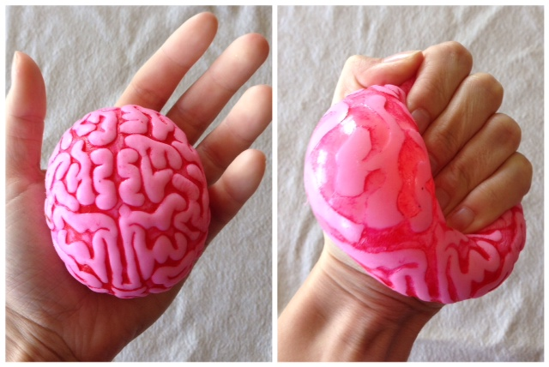
Wall the Werrors
always try to use -Wall -Werror with gcc.
in any other language, turn on all the error checking you can.
while developing, enable debugging info. (gcc -g)
your brain is squishy and can't handle everything.

Slide 7
WRITE TESTS
ideally, you write a test for each of your small functions
Good things to test
normal conditions
correct outputs
weird inputs
error conditions
"contracts"
effects on state
state is, broadly, "the variables and environment outside of the function."
look into testing frameworks for your language. most have them.

Slide 8
Use the right programming language
if you’re trying to avoid bugs… don’t use a language that’s bad at the problem that you’re trying to solve!
if your program does a lot of string manipulation, C is a terrible choice!
if you’re trying to represent data structures where 99.999% of the pointers aren’t null, Java is a terrible choice!
and you don’t need to use one programming language for the whole whatever-it-is. it’s totally okay to use multiple languages to play to their strengths.

Slide 9
So something went wrong.

Slide 10
Step 1: admitting you have a problem
a crash is an obvious indication that something is wrong.
in C, you can use a debugger (gdb) to get a stack trace.
but many problems don't lead to a crash…
in that case, you need to follow the control flow
at some point, your program goes from "working correctly" to "something is bad."
your job is to find that point; do not try to guess based on the output or the final results.
Notes:
- programs are proofs (thanks, Howard-Curry isomorphism!)
- and like a proof, you can make mistakes in your assumptions or proof rules; you can do great for several steps and then oops.

Slide 11
printf("x = %d\n", x);
you can absolutely use prints or logging frameworks (e.g. Log4J in Java) to spam informational messages as your program runs
logging frameworks let you have a "severity" for each message
"debug", "info", "warning", "error", "fatal"
if you don't already have prints, using a debugger to follow control flow is probably easier than writing a bunch in there.
especially since you have to remove/comment them out later.

Slide 12
Step 2: determining the cause
once you pinpoint the location…
the cause may or may not be obvious.
Rectangle r = get_bounding_rect();
int x = do_a_thing(r.x, r.y, r.x + r.width, r.y + r.height);
int y = smth_else (r.y, r.x, r.y + r.width, r.x + r.height);
copy-and-paste errors are often hard to spot.
splitting code into smaller functions can help avoid this.
if(x < 0) {
do_one_thing();
} else if(x > 0) { do_another();
}
missing cases are another common problem – and you don't see them cause they're not there.
Notes:
- we probably shouldn't be adding the y coordinate to the width… we probably meant to swap width and height too.
- what if x == 0?

Slide 13
Check your assumptions
assumptions are "shoulds"
"when I enter this function, what should the parameters be?"
"when I return this value, what should it look like?"
"after this search loop, what should be in this variable?"
"when this method runs, what state should the object be in?"
assertions are a great way to catch bugs early during development
Java has em. C has em.
assertions should only be used to test for things that should be absolutely impossible to happen under any circumstance.
#include <assert.h>
...
assert(x >= 0);
assert(self.state == READY);
don't e.g. use them to check parameters on a public method.

Slide 14
Working backwards from crashes
when a program crashes…
fairly often, that specific line is not at fault.
it's because some earlier code broke things, and your program kept running for a while until things finally crashed.
like a ticking time bomb.
look at what happened immediately before.
set breakpoints earlier than the crash and re-run the program.
check out what's happening at those breakpoints.
then step closer and closer to narrow down the actual error location.

Slide 15
Finding bugs faster

Slide 16
IDEs
IDEs can continually compile and find errors
they can make suggestions to fix them
or show help on functions while you write so that you don't make mistakes to begin with
IDEs can be a helpful tool…
but they can also be so complex that you just get overwhelmed by all the settings and features.
probably the nicest feature of IDEs is an integrated debugger
no need to use arcane typed commands

Slide 17
Debugger breakpoints
a breakpoint lets you pause the program and look around.
in gdb:
b func will pause whenever func is called.
b lab4.c:45 will pause when line 45 of lab4.c is reached.
b *0x8004030 will pause when the PC gets to address 0x8004030.
b location if x == 5 will pause at a location but only if the condition is satisfied. location can be any of the above.
tb location is a breakpoint that only happens once – it's deleted after the first time it's hit. (you can make these conditional too.)
check out the breakpoint features in your IDEs!

Slide 18
Watchpoints
sometimes a variable gets set to some weird value and you don't know where or when it happens.
a watchpoint is like a breakpoint, but it pauses whenever a variable is about to be written (or read, or both).
in gdb:
watch globalvar will pause when a global variable is changed.
watch localvar will only work when you are paused in a function, and it will last until the local variable goes out of scope.
rwatch and awatch work the same, except they pause when a variable is read (rwatch) or on all accesses (awatch).
you can't set a condition on these, sadly…

